Slide 1
Annual Report
Youth in Federal Discourse
October 6, 2021

Slide 2
Agenda
01. Introduction
02.Meetings
Youth in Federal Discourse (YFD) is a non-governmental organization (NGO) registered in 2021 A.D at the Kathmandu District Administration Office.
The total participation rate in meetings increased from 43 % to 50% between 2019 - 2020.
03. Programs
04. Executive Team
05. Closing
The overall growth based upon the number of programs being conducted shows that the rate has been doubled in two years.
Gratitude to the old team and welcome to the new one.
Summary and vote of thanks.

Slide 3

Introduction
Non-governmental organization (NGO)
registered in 2021 A.D
“Engage Nepali youths in understanding federalism”
need of intervention to provide some stability to the system
work as a think-tank
review actions of government and its agencies
9+ partnerships, 10+ productive programs, 3000+ engagements, 250+ impact

Slide 4

2019/2020 - 2020/2021

Slide 5
Meetings in Sector table
Year / Month | M1 | M2 | M3 | M4 | M5 | M6 | M7 | M8 | M9 | M10 | M11 | M12
2019 |  |  |  |  |  |  |  |  | 1 | 1
2020 | 1 | 1 | 3 | 2 | 1 | 1 | 2 | 2 | 3 | 2 | 4 | 3
2021 | 2 | 3 | 4 | 5 | 4 | 4 | 5 | 4 | 5

Slide 6
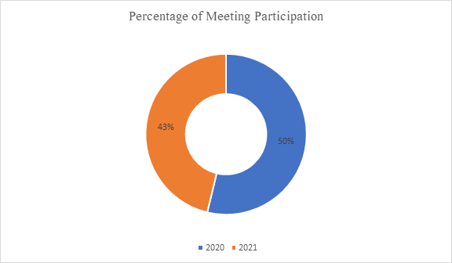
Participation in graph

Slide 7
Meeting Highlights
2020
Podcast
Website Framework
Open Twitter Account
Pre-Report and Post-report Financial Report
Regular Skills Development Training
Blog
Drafting General Constitution of organization
2019
Modality Discussion for MPA Program
Changing the structure of the organization
Member nomination/selection
Logo Finalization
Partnership Scheme
Research
Video Campaigning
Discussion series
Partnership proposal
2021
Campus Representative Guidelines
Volunteer Guidelines
General Member selection U.S. Embassy Grant
Model Local Assembly
Registration
Hiking
Department Formation
Financial Guideline
Bidhan Amendment
Website
Thesis Presentation
Rules and Guidelines

Slide 8
“Coming together is a beginning; keeping together is progress; working together is success.”
-Henry Ford

Slide 9
Programs in Sector table
Year | No. of Programmes
2019 | 1
2020 | 4
2021 | 2

Slide 10
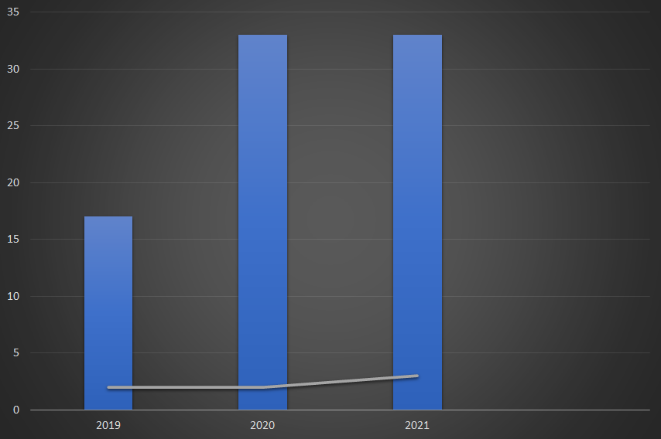
Overall Growth in graph
Assumptions
The data for the year 2019 is taken from September to December.
The data for the year 2021 is taken from January to September.
The given period for both 2019 and 2021 is considered 100%.
Every month, the goal is to complete at least one program.

Slide 11
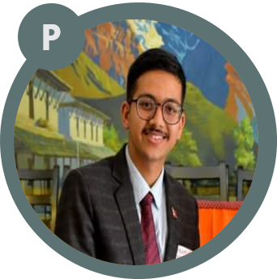

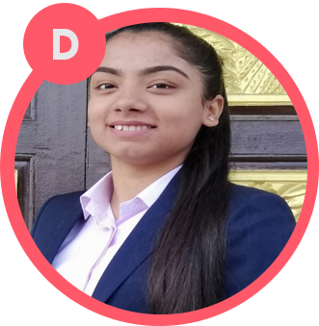

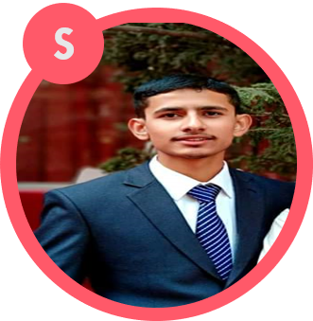

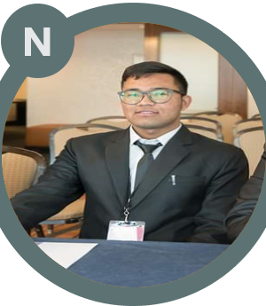

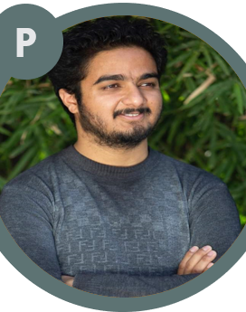


Team for 2021/2022
Prajwol B. Rana
Sujata Bastola
Dipsikha Guragain
Sabina Acharya
Shreeram Pokhrel
President
Vice-President
General Secretary
Secretary
Treasurer
Dikpal Khatri
Chhetry
Nikhil Dongol
Purak Adhikari
Pravin Bhatta
Rakshya Awasthi
Rupika Budha Shrestha
Executive Member
Executive Member
Executive Member
Executive Member
Executive Member
Executive Member

Slide 12
Departments
Permanent Departments
Temporary Departments
Discussion Series Team
Podcast Team
Blog Team
Social Media Team
Partnership and Outreach Team
Human Resource Team
Medical Negligence
AGM Team
Reform MPA / MLA Team
Research Team (Whip & RTI)
Thesis Presentation Team
Bidhan Review Team
Renew Organization Team

Slide 13
Summary
We are successful in conducting great number of meetings.
Our Team Participation is good.
Total percentage of meeting increased to 100% in 2021 from 48% in 2020.
Total percentage of participation in the year of 2020 43% is and 2021 (till September) is 50%.
We’ve successfully met our target.
We’ve reached our targets.
All members are completely engaged, and our permanent and temporary departments have successfully begun their work.
Engage 3000+ youths in federal discourse.
We’ve increased our team.
From the 11 team members in the year of 2019 we have increased to 16 in 2020 and 21 in 2021.

Slide 14

Thank you
Thanks to your commitment and strong work ethic, we know next year will be even better than the last.
We look forward to working together.
Youth in Federal Discourse
connect@yfd.org.np

